Slide 1
Final report on Traffic Alert Research
Zheng Wei
Sep 2018
©2017 PayPal Inc. Confidential and proprietary.
Notes:
Hi Janice, hi everyone, the theme of my summer project is traffic alert research

Slide 2
Project Overview
Background
Workflow
Focus & Study
Summary
Plan
Notes:
I will introduce the project from the following aspects: background, workflow, focus&study, summary and plan.

Slide 3
Background
Transactions with tags
All attempts
Declined by frontend Models(CAM, ATOM…)
Var & bad rate
New attribute
Alert
Based on merchants
Notes:
Now let‘s first look at the background. As we all know, we have thousands of transactions in PayPal all the time, then these transactions will be first declined by frontend models, so we can get a lot of transaction information they have good or bad tags. And from the perspective of merchant, each merchant will accumulate a lot of transaction information with tags, that is, transaction information with bad rate. And our frontend model is based on transaction level, so these models tend to ignore the variables that can be extracted based on the merchant level. So the focus of my project is to explore some variables that can be associated with bad rate or under attacked. And Based on the merchant, we can use the variable to feed back the frontend model. We can also do some alert related to the attempts.

Slide 4
Background
Transactions with tags
All attempts
Declined by frontend Models(CAM, ATOM…)
Var & bad rate
New attribute
Alert
Based on merchants
Notes:
Now let‘s first look at the background. As we all know, we have thousands of transactions in PayPal all the time, then these transactions will be first declined by frontend models, so we can get a lot of transaction information they have good or bad tags. And from the perspective of merchant, each merchant will accumulate a lot of transaction information with tags, that is, transaction information with bad rate. And our frontend model is based on transaction level, so these models tend to ignore the variables that can be extracted based on the merchant level. So the focus of my project is to explore some variables that can be associated with bad rate or under attacked. And Based on the merchant, we can use the variable to feed back the frontend model. We can also do some alert related to the attempts.

Slide 5
Workflow
Variables
(Categorical, Continuous)
Design Statistics
New attributes
TPV
Suc_num
USD_amt
Model_score
Sndr_days_on_file
Sndr_IP4
Sndr_country
……
Distinct Number
Proportion shift
Top percentile
Velocity change
Average
Sum
……
Bias rank
Gap rank
Correlation
Complex statistic
……
Notes:
Okay, let‘s take a look at the workflow. The process is probably like this. We can get a series of Variables from the data accumulated by the merchant. Then we can get a series of statistics based on these Variables, and find some relationship between these statistics and bad rate. Of course, sometimes these statistics do not relate to the bad rate. We may need to further construct some Variables based on these statistics such as bias rank, gap rank and etcetera

Slide 6
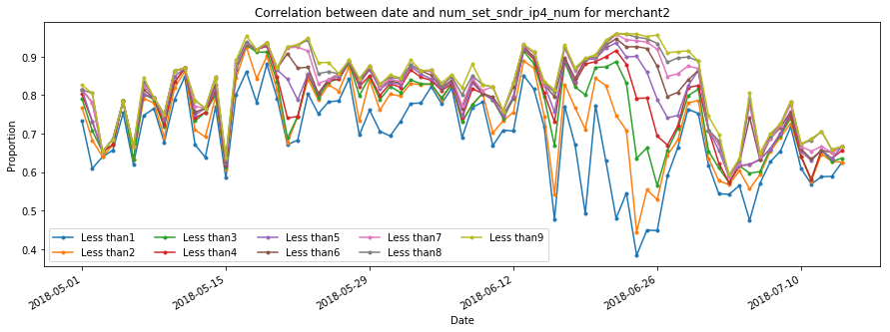
Workflow
Correlation between date and Sndr_days_on_file
Notes:
Then, all three figures are based on a merchant‘s information. The first thing we need to know is that the time period marked in red in the figure represents that this merchant was under attacked during this time. Then let’s take a look at some of the performance of Variable. In the top left picture, the three lines represent the number of successful transactions, the successful and marked as good, and the number of the declined. We can see that these three Variables have a steep rise during this time, which can be related to the attack of this merchant. Then we can look at the picture on the right. We can find out that the score given by the cam model is reduced during the period when the merchant is under attacked, which means that the cam model did not perform well in this case. The bottom line describes a performance of the sndr_days_on_file at different times of the gap‘s proportion. Sndr_days_on_file refers to the gap from the date of account registration to the time when the transaction occurred. The horizontal axis is the date, and the vertical axis is the proportion. The nine lines in the figure refer to gap less than one, and less than two , and so on. it is less than nine. Then we can know that the bottom line obviously means less than one, and the share is the lowest, and the highest is less than nine. We see that during this period of time when the merchant was under attacked, the gap between the shares of different registration times was significantly larger than the average. So this is a variable related to under attacked.

Slide 7
Focus
sndr_ip4_num
sndr_country
Distinct number
Bad Rate
Under Attacked
Alert
Distinct number
Proportion shift
Notes:
Okay, this time we mainly discuss the two variables. They are sender IP and sender country. We mainly look at their distinct number and proportion shift. Then look for the relationship between these statistics and the bad rate under attacked or the info related to alert.

Slide 8
Study
FROM pp_risk_ops_views.unified_dataset_v3 t2
inner join pp_risk_roe_views.seller_seg_bu_his_temp seg
on t2.rcvr_id = seg.cust_id
and seg.SEG = 'Commercial’
and t2.pmt_start_date between '2018-04-01' and '2018-04-30'
SQL:
Dataset info:
RCVR_ID: 634, 252
Transaction: 568, 058, 495
pmt_start_date:
2018/04/01 ~ 2018/04/30
Notes:
let's take a look at the data set. We selected the data set from April 1 to April 30 this year. A total of more than 630,000 rcvr_id, and more than 500 million transactions

Slide 9
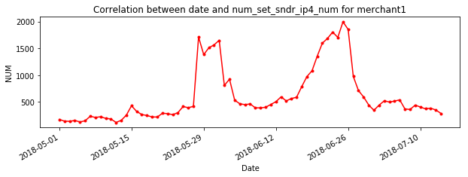
Study distinct number of sndr_ip4_num
DN_shift: (DN – his_avg_DN) / his_avg_DN
BR_shift: (BR – his_avg_BR) / his_avg_BR
Sliding window
Notes:
Let‘s first look at the case of the distinct number of sender IP.The picture on the left still corresponds to the previous merchant. We can find that it has a steep rise in its distinct number of sender IP during the period marked in red, namely under attacked, then at the overall level,is there also the good performance of this Variable? We can look at the picture on the right. The two curves represent the average of the more than 600,000 merchants and the average of the bad rate. From this picture alone, we can't find any obvious relationship between these two quantities. Especially in the section marked in red in the figure, where the bad rate shifts, the distinct number is changing in the opposite direction. For a more in-depth study, we introduce two new statistics, which are distinct number shift and bad rate shift. They are calculated by subtracting the historical mean from the value of the day and dividing by the historical mean. Then the calculation of this historical mean, we take the average of the data from the previous month from the day as its historical mean. In other words, we select a sliding window for each value to calculate.

Slide 10

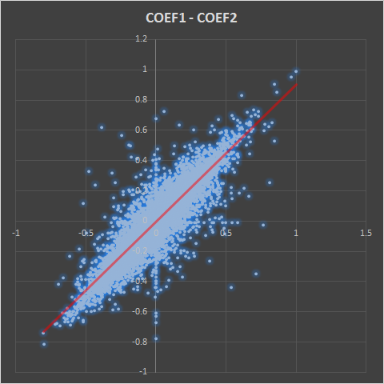
Study distinct number of sndr_ip4_num
person correlation coefficient
COEF | BR_DN | BR_DN(shift)
+ | 5777 | 5766
- | 6701 | 6799
AVG | -0.013 | -0.016
COEF2 > 0.6: 46
avg tot_num: 4717.5 ( > 944.7)
COEF2 < - 0.6: 28
avg tot_num: 16436 ( >> 944.7)
Notes:
Okay, there, we need to introduce the concept of Pearson correlation coefficient. This is the amount used to describe the consistency of changes in two variables. If the correlation coefficient of the two Variables is larger, it means that their correlation is greater. And vice versa. The range of the correlation coefficient is from negative one to one. If this value approaches 0, it means that the two Variables have nothing to do with it. Let's take a look at this statistical table below. This counts the relationship between bad rate and distinct numbers and their respective shifts. In order to make the data of the study more representative, we have filtered the RCVR_ID. We select some rcvr_IDs with large TPVs and whole historical data. There are more than 10,000 in total. Then the two correlation coefficients are positive and the number is less than 1000. And their mean is a relatively small negative number, showing a weak negative correlation. Let's take a look at the picture on the right, which is the relationship between the two correlation coefficients. We found that it is almost possible to fit this scatter plot with a straight line of y=x, so this shows that there is no shift in the research value. Then let's look at the case of a larger correlation coefficient. There are 46 merchants with its value over 0.6, and the correlation coefficient is lower than -0.6. There are 28 merchants. And the average daily volume of these merchants is greater than the average of all merchants. So we can say that the big probability that the distinct number and the bad rate show a strong correlation is large merchant, and in turn, the large merchant does not necessarily show a strong correlation.

Slide 11
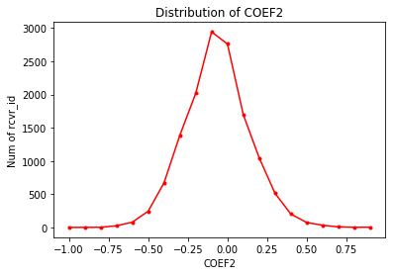
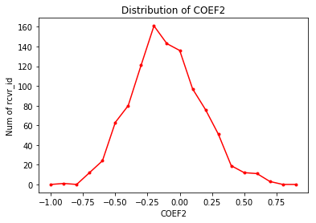
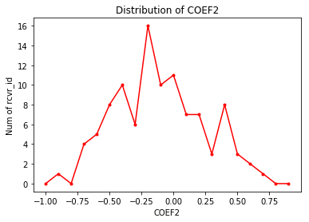
Study distinct number of sndr_ip4_num
Totally
close to standard normal distribution
Top 1000
close to normal distribution
with a mean of -0.2
Top 100
Notes:
Okay, let's take a look at the overall distribution of this correlation coefficient. Overall, the correlation coefficient is close to the standard normal distribution, which means that the distinct number of sender IP is not a good performer for all merchants. At the top TPV level, we can see that the distribution of correlation coefficients is close to a normal distribution with a mean of -0.2.

Slide 12
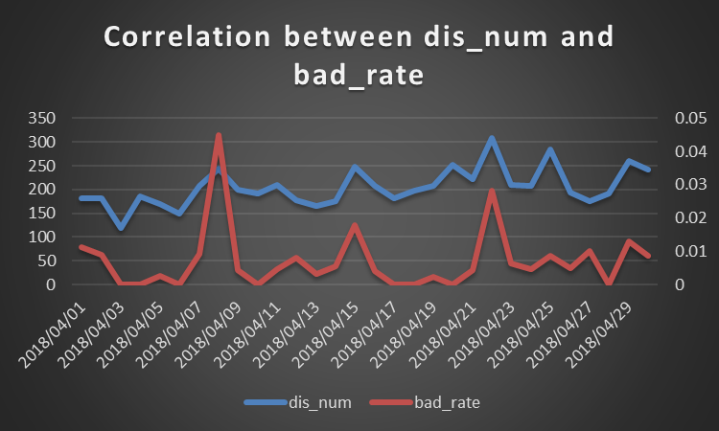
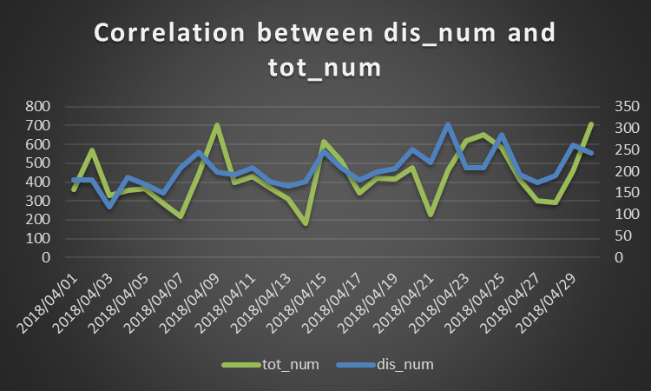
Study distinct number of sndr_ip4_num
A large merchant (id: 2107515622657774954)
Notes:
Ok, now let's take a look at the positive and negative correlation top cases. This is positively related. The blue line on the left represents the distinct number, and the red line represents the bad rate. The blue on the right is still the distinct number, and the green is tot_num. From the left picture we can see that in the case of a sudden rise in the bad rate, it is often accompanied by the same change of distinct number. And through the right picture we can find that the increase in distinct number is often accompanied by an increase in tot_num. This situation is often the result of there are more bad transactions in newly added transaction of the merchant, so the bad rate rises relatively.

Slide 13
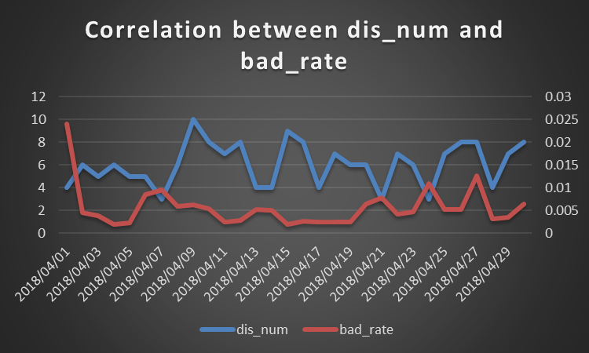
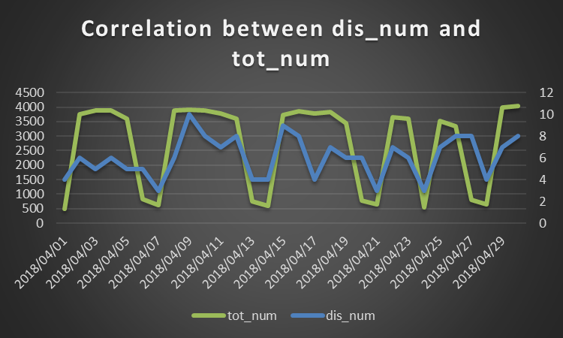
Study distinct number of sndr_ip4_num
A large merchant (id: 2172380242254638677)
Notes:
Then this is a case of negative correlation. We can see that where the bad rate rises, the distinct number is often reduced. At the same time, it is accompanied by a decrease in tot_num. After studying a lot of similar cases, we found that the main reason is that the reduced transactions are mostly good transactions, so the bad rate rise relatively.

Slide 14
Study distinct number of sndr_ip4_num
Conclusion
Correlation with bad rate depends on merchant
COEF’s distribution
Close to standard normal distribution totally
Close to normal distribution with a mean of -0.2 on merchants with large TPV
The negative correlation is mainly caused by inconsistencies of growth between
TPV and the bad.
Notes:
Okay let us summarize the conclusion about the distinct number of sender IP
First we know that the correlation between distinct number and bad rate depends on the specifi cmerchants.
Second, as just mentioned, we can get the information of distinct number and bad rate distribution.
Finally, we can explain some merchant trends

Slide 15
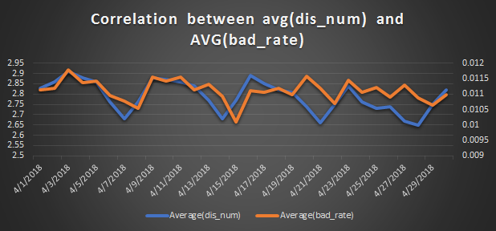
Study distinct number of sndr_country
Totally:
Dataset info:
RCVR_ID: 63, 4252
Transaction: 568, 058, 495
pmt_start_date:
2018/04/01 ~ 2018/04/30
Notes:
Okay, now let's look at the information about the distinct number of the sender country. Then the framework for studying this is roughly the same as the framework for researching sender IP. We used the same data set. First look at the performance of the overall. The two polylines of this picture are the average of distinct number and the bad rate. We can see that their changes are consistent over certain time periods, such as the one marked in blue in the figure. Then, let's take a look at the relevant information on merchant level.

Slide 16
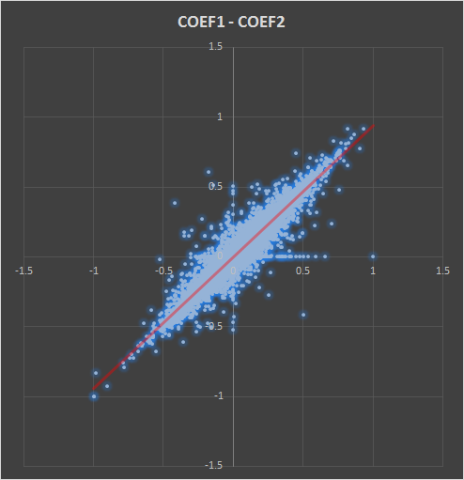
Study distinct number of sndr_country
COEF | BR_DN | BR_DN(shift)
+ | 6773 | 6651
- | 5769 | 5815
AVG | 0.02482 | 0.02183
Notes:
Different from the performance of the sender's IP, the number of positive correlation coefficient is more than 1000 to the negative, and the overall average correlation coefficient is around 0.02, showing a weak positive correlation.

Slide 17
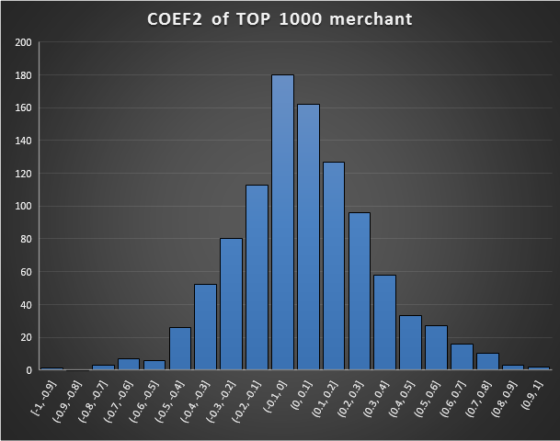
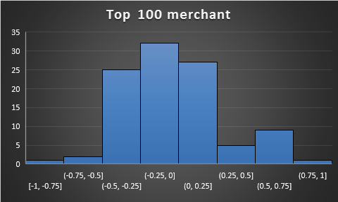
Study distinct number of sndr_country
Notes:
Let’s look at the distribution of correlation coefficients from the perspective of the top TPV. On the rcvr_id of top1000, the distribution is very close to the standard normal distribution, but on the rcvr_id of top100, we can see that the number of rcvr_ids with correlation coefficients in the range of -0.5~-0.25 accounts for a quarter.

Slide 18
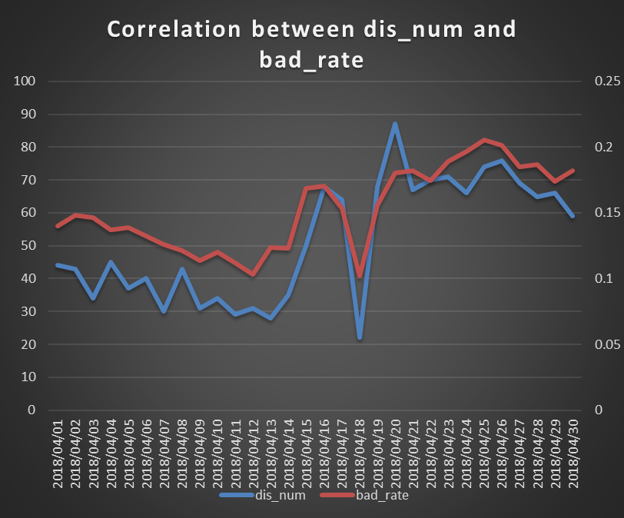
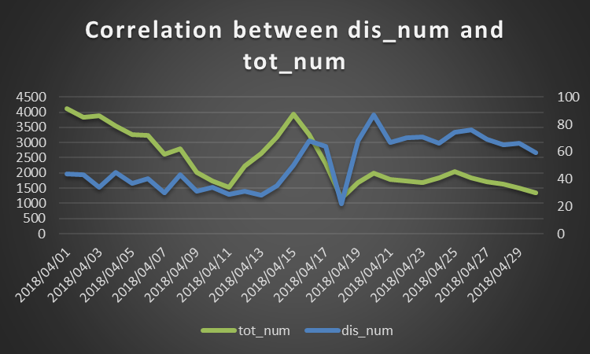
Study distinct number of sndr_country
A large merchant(id: 1363174192714401239)
Notes:
Again, let's take a look at two top cases. The first is a positive correlation. We can see that there is an obvious shift in the distinct number in the case of an obvious shift in the bad rate. And the accompanying tot_num is synchronously changed.

Slide 19
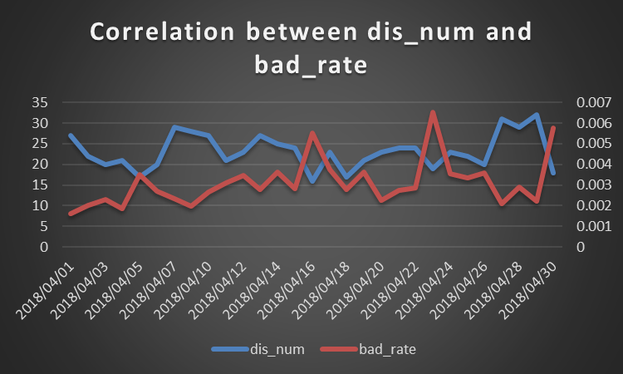
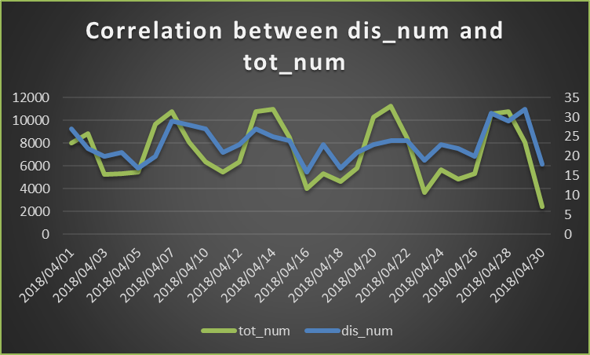
Study distinct number of sndr_country
A large merchant(id: 1531398633589183775)
Notes:
This is the negative correlation example. Similar to sender Ip.

Slide 20

Study Proportion shift of sndr_country
Ordered by tot_num
Original dataset
Top 1000 merchant
& daily trans $≥$ 1000
RCVR_ID: 1000
Transaction:29936
pmt_start_date:
2018/04/01 ~ 2018/04/30
Dataset info:
Notes:
Okay Next we look at the last Variable, proportional shift of sndr_country. In order to study the data more representative and considering the calculation time, we selected 1000 top merchants, and their daily volume exceeded 1000. Then the data set is shrunk to a thousand rcvr_Id and has about 30,000 transactions. Pmt_start_date has not changed.

Slide 21
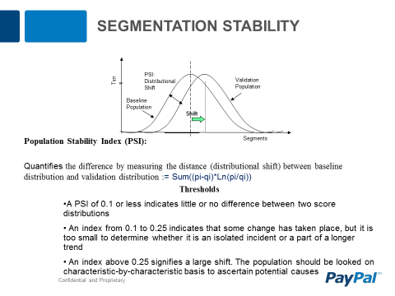
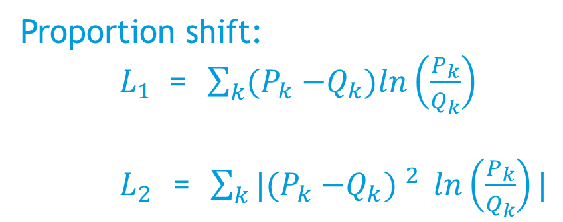
Study Proportion shift of sndr_country
For a merchant:
Country | Time P | Time Q
A | 20% | 30%
B | 30% | 40%
C | 40% | 10%
D | 10% | 20%
Proportion shift:
$L_{1}$ = $\sum_{k}{{(P}_{k} −Q_{k}})ln\left(\frac{P_{k}}{Q_{k}}\right)$
$L_{2}$ = $\sum_{k}{|{(P}_{k} −Q_{k}) ^{2}} ln\left(\frac{P_{k}}{Q_{k}}\right)|$
Notes:
For the proportional shift of sndr_country, we refer to PSI, an indicator describing the distribution shift to construct indicators that describe the promotion shift, such as L1 and L2 in the lower right. We can think of the information of the share of merchants in different countries at a time as a vector. Then the proportion shift is equivalent to calculating the distance at different times and then assigning a change weight.

Slide 22
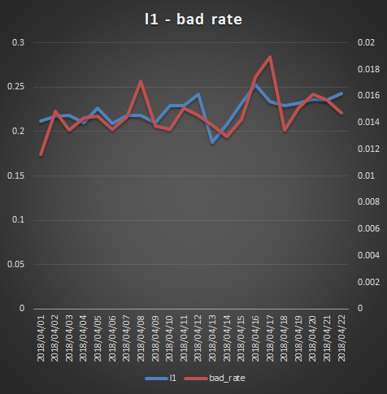
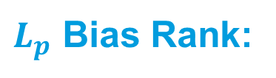
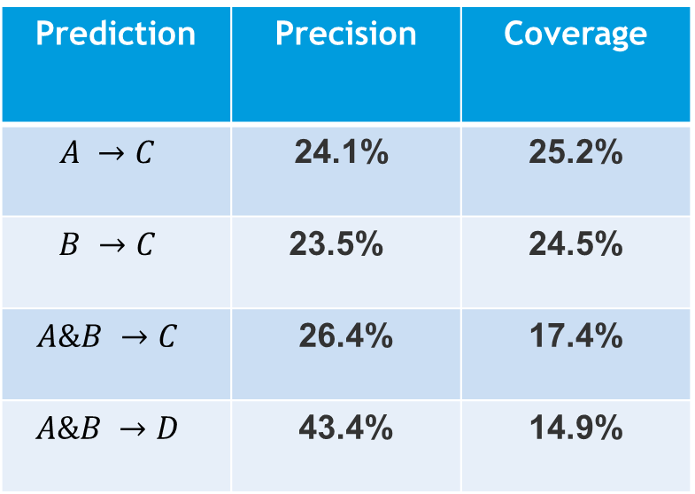
Study Proportion shift of sndr_country
A: l1_pos is less than or equal to 5 (5627)
B: l2_pos is less than or equal to 5 (5627)
C: bd_pos is less than or equal to 5 (5382)
D: bd_pos is less than or equal to 10 (10336)
A & B: 3533
Shift of L1(2) predicting shift of bad_rate
$L_{p}$ Bias Rank:
1
Prediction | Precision | Coverage
$$A →C$$ | 24.1% | 25.2%
$$B →C$$ | 23.5% | 24.5%
$$A\&B →C$$ | 26.4% | 17.4%
$$A\&B →D$$ | 43.4% | 14.9%
Notes:
Then we mainly want to use the shift of L1 and L2 to predict the shift of bad rate. We create an indicator called bias rank. This indicator refers to the ranking of the current moment away from the mean over a period of time. For example, as shown in the figure below, for the red line bad rate, the red horizontal line is its mean value, then the place marked 1 in the figure is obviously the farthest from the mean, so its rank is also the highest. For other indicators and so on. Then we look at the four events shown on the top right, where A is the number of transactions in the top 5 of the rank representing L1. And so on, B, C, D. Then we can get the following evaluation matrix. For example, for the first line, it means that when the rank of L1 is in the top 5, precision and coverage of the bad_rate is in the top 5. The calculation of precision is A&C divided by A, and the calculation of coverage is A&C divided by C. So from the first line, we can conclude that when the rank of the shift in which L1 occurs is the top five of the month, the probability that the bad rate shifts to 24.1% is also in the top five. The conclusions of other lines are similar.

Slide 23

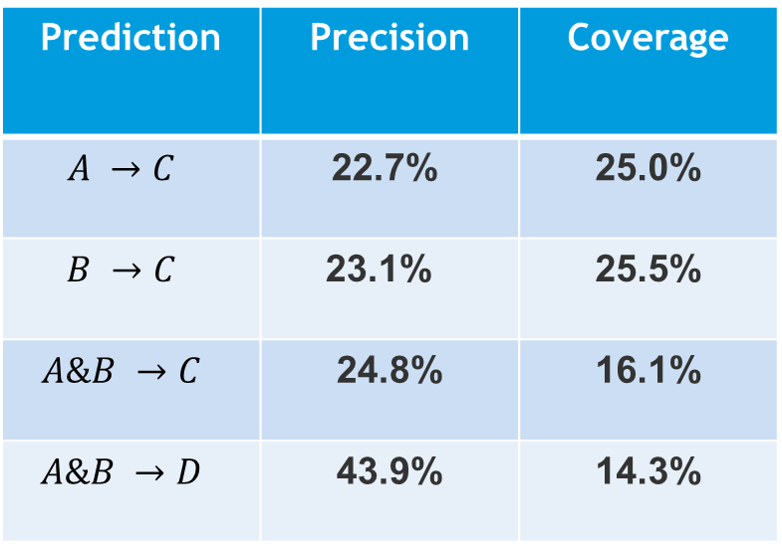
Study Proportion shift of sndr_country
A: l1_pos is less than or equal to 5 (5598)
B: l2_pos is less than or equal to 5 (5598)
C: bd_pos is less than or equal to 5 (5078)
D: bd_pos is less than or equal to 10 (10093)
A & B: 3281
$L_{p}$ Gap Rank:
1
Prediction | Precision | Coverage
$$A →C$$ | 22.7% | 25.0%
$$B →C$$ | 23.1% | 25.5%
$$A\&B →C$$ | 24.8% | 16.1%
$$A\&B →D$$ | 43.9% | 14.3%
Notes:
This is a similar indicator: Gap rank. Unlike the bias, this is mainly to compare the rank of the sum of the absolute values of the day and the day before and after the gap. So the same picture, the position where rank is 1 has also changed accordingly. The position with rank 1 in the figure represents the maximum gap between it and its neighbors. Then we can get a similar evaluation matrix.

Slide 24
Study sndr_country
Conclusion
Distinct number
Correlation with bad rate depends on merchant
There are more negative correlation on top 100 merchants
Proportion shift
L1 & L2 can depict the trend of bad rate in some degree but affected by tot_num
The big shift of L1 & L2 can predict the bad rate’s
Notes:
Let us summarize it,
For the distinct number of the sender country, our conclusion is somewhat similar to the sender IP, ie the first correlation depends on the merchant, and the second distribution on the top100merchant tends to be negatively correlated.
For the proportion shift of sender country, we can use the shift of the two indicators L1 and L2 to describe the shift of the bad rate to a certain extent, and it also proved our framework is valid.

Slide 25
Summary
Make specific solution for merchants
Design a set of frameworks for similar variable analysis
Role as variable of frontend models
Explain merchant’s trend
……
Notes:
Regarding summary, we have the following:
First, we can develop a specific solution for many mercants
Second, we have designed a framework that can be used for similar variable analysis.
Third, our proposed Variable can be used in the frontend model.
Finally, we can explain the change of merchant by analyzing the Variable.

Slide 26
Plan
Expand the framework
Verify these feature in other different dataset
Extract more attributes
……
Notes:
As for the plan, I think the main points are as follows:
Are respectively
And we can extract more variables related to bad rate from merchant’s trasaction information.
and many more

Slide 27
Q & A
Notes:
Okay, this is all, any questions?

Slide 28
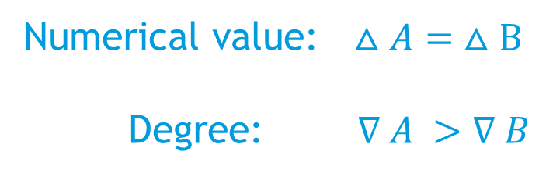
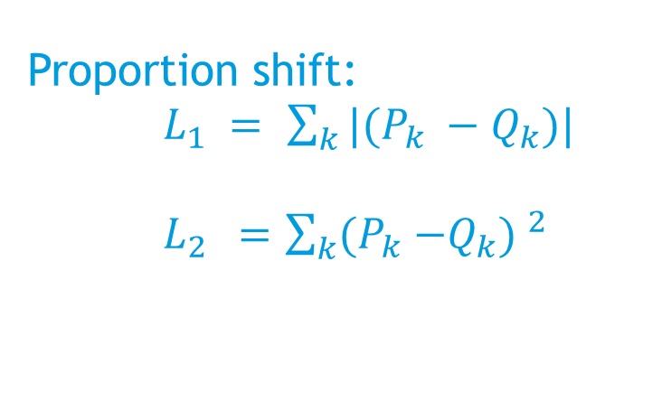
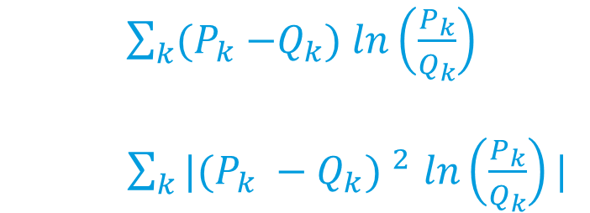
Study Proportion shift of sndr_country
Country | Time P | Time Q
A | 5% | 10%
B | 45% | 55%
… | … | …
Numerical value:$△A= △B$
Degree:$∇ A >∇ B$
Proportion shift:
$L_{1} =$ $\sum_{k}{{|(P}_{k} −Q_{k}})|$
$L_{2 } =$ $\sum_{k}{{(P}_{k} −Q_{k}) ^{2}}$
$\sum_{k}{{(P}_{k} −Q_{k}}) ln\left(\frac{P_{k}}{Q_{k}}\right)$
$\sum_{k}{{|(P}_{k} −Q_{k}) ^{2}}$ $ln\left(\frac{P_{k}}{Q_{k}}\right)|$
Plus weight

Slide 29
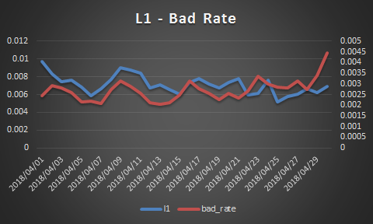
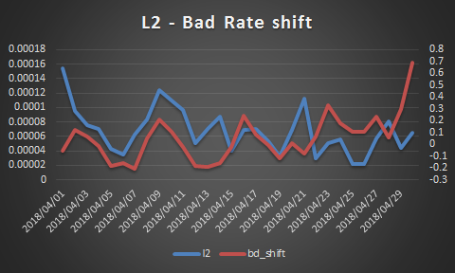
Study Proportion shift of sndr_country
A large merchant(1931414401940183232):

Slide 30
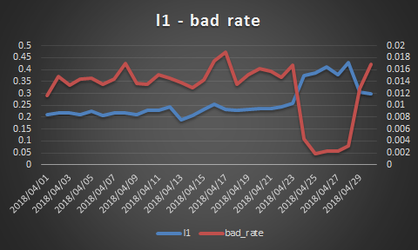
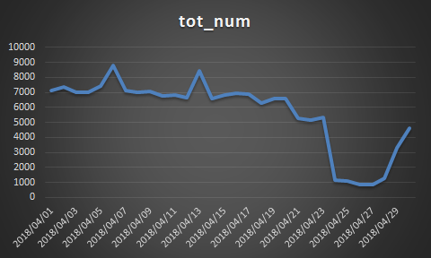
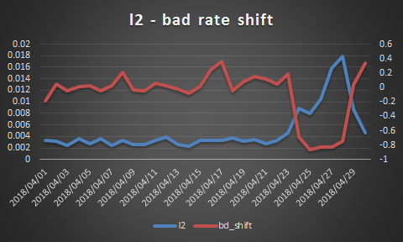
Study Proportion shift of sndr_country
A large merchant(1809909810376487672):

Slide 31
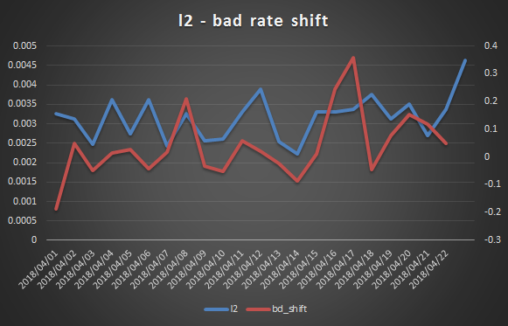
Study Proportion shift of sndr_country
A large merchant(1809909810376487672):
COEF1: 0.57
COEF2: 0.35

Slide 32
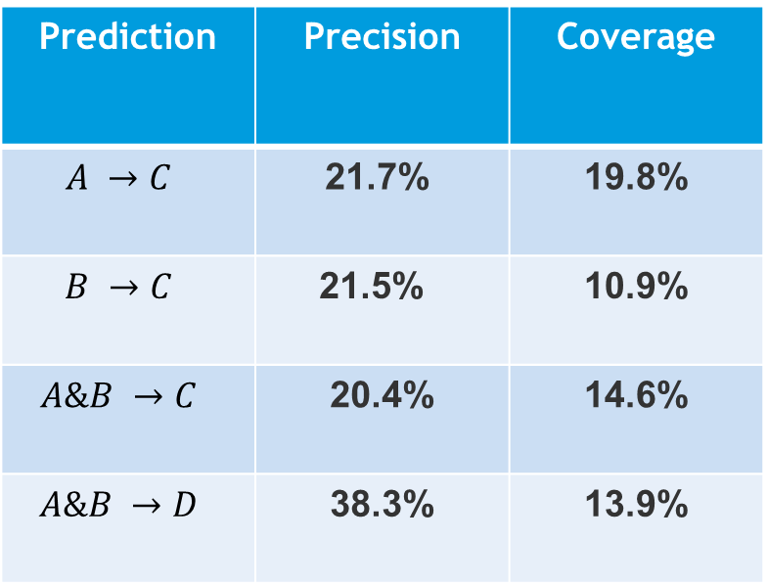
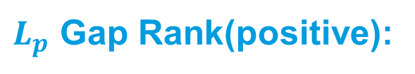
Study Proportion shift of sndr_country
Merchant: L1& L2 fitting bad rate
Model: The shift of L1 & L2 predicting the bad rate’s
$L_{p}$ Gap Rank(positive):
Prediction | Precision | Coverage
$$A →C$$ | 21.7% | 19.8%
$$B →C$$ | 21.5% | 10.9%
$$A\&B →C$$ | 20.4% | 14.6%
$$A\&B →D$$ | 38.3% | 13.9%
l1(2)_dis be difference with daily l1(2) and average l1(2)
l1(2)_pos be the top rank of sorted list containing l1(2)_dis.
A: l1_pos is less than or equal to 5 (5596)
B: l2_pos is less than or equal to 5 (5598)
C: bd_pos is less than or equal to 5 (5119)
D: bd_pos is less than or equal to 10 (10091)
A & B: 3659

